Slide 1
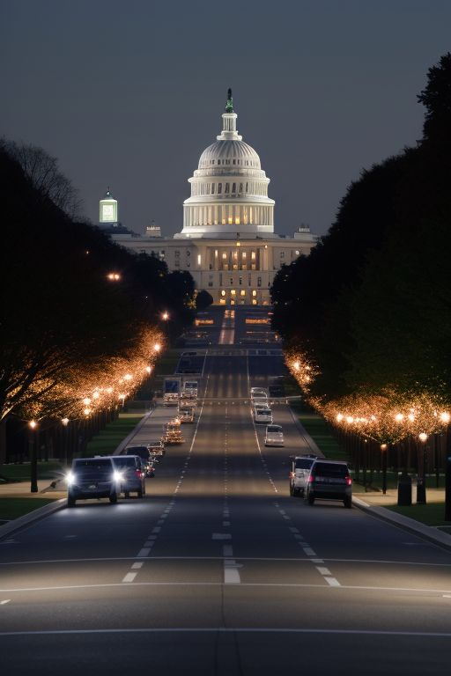
Washington DC Street Light Visualisation and Analysis
Data Visualisation Track
Group 2
Fabiano Santos
Madeleine Chapman
Oliver Uy
Laura Rui Liu
Lewis Trenerry

Slide 2

Data
Washington DC Street Light data
CSV file consisting of 72k rows
Cleaned and stored in pandas dataframe
Astronomical daylight /darkness data for Washington DC
Web page scraped for 2023 data
Data cleaned and summarised in data frame by month and total time of darkness
Combining data sources
Created PostgreSQL databse
Integrate data and merge tables

Slide 3
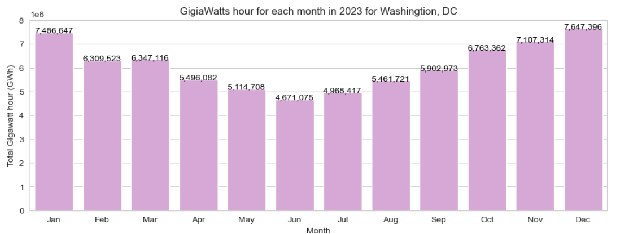
Bar Chart
Libraries used:
seaborn
Matplotlib.pyplot

Slide 4
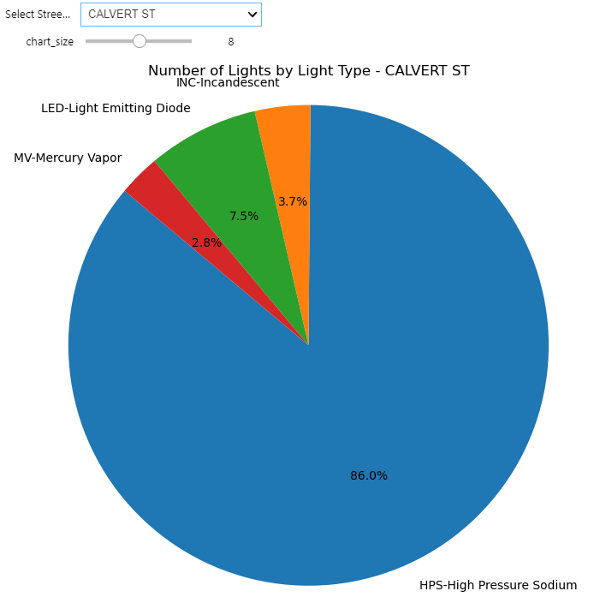
Pie Chart
Libraries used:
Matplotlib.pyplot
Ipywidgets to enable interactive dropdown box

Slide 5
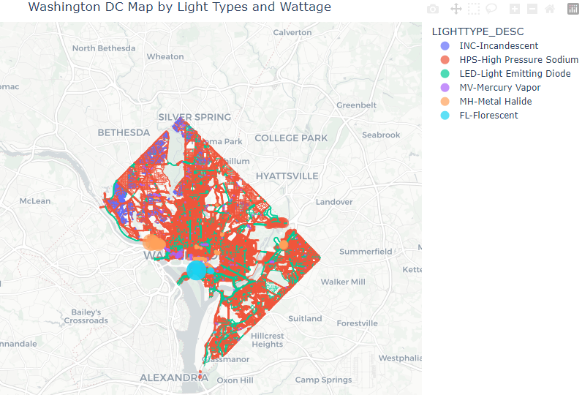
Map
Libraries used:
geopandas
shapely.geometry
plotly.express

Slide 6
Insights and Conclusion
xxxxx

Slide 7
References
OpenAI. (2024). ChatGPT. Retrieved April 11, 2024 from https://openai.com/chatgpt
OpenData DC. (2024). Streetlight Locations. Retrieved April 4, 2024, from https://opendata.dc.gov/datasets/6cb6520725b0489d9a209a337818fad1_90/explore?location=38.894874%2C-77.022089%2C15.00
Perchance. (2024). AI Text-to-Image Generator. Retrieved April 13, 2024, from https://perchance.org/ai-text-to-image-generator
Plotly. (2024). Mapbox Density Heatmaps. Retrieved April 9, 2024, from https://plotly.com/python/mapbox-density-heatmaps/
U.S. Naval Observatory. (2023). Daylight Duration for Washington, DC. Retrieved April 4, 2024 from https://aa.usno.navy.mil/calculated/durdaydark?year=2023&task=1&lat=38.89&lon=-77.03&label=Washington%2C+DC&tz=5&tz_sign=-1&submit=Get+Data

